Slide 1


Slide 2
Chapter 13
Aggregate Planning
Notes:
2
2

Slide 3
OBJECTIVES
Sales and Operations Planning
The Aggregate Operations Plan
Examples: Chase and Level strategies
Notes:
2
2

Slide 4
Exhibit 13.1
Process planning
Long
range
Strategic capacity planning
Intermediate
range
Forecasting & demand management
Sales and operations (aggregate) planning
Sales plan
Aggregate operations plan
Manufacturing
Services
Master scheduling
Material requirements planning
Weekly workforce and
customer scheduling
Order scheduling
Short
range
Daily workforce and customer scheduling

Slide 5
Sales and Operations Planning Activities
Long-range planning
  Greater than one year planning horizon
  Usually performed in annual increments
Medium-range planning
  Six to eighteen months
  Usually with monthly or quarterly increments
Short-range planning
  One day to less than six months
  Usually with weekly increments
Notes:
3
3

Slide 6
The Aggregate Operations Plan
Main purpose: Specify the optimal combination of
  production rate (units completed per unit of time)
  workforce level (number of workers)
  inventory on hand (inventory carried from previous period)
Product group or broad category (Aggregation)
This planning is done over an intermediate-range planning period of 6 to18 months
Notes:
6
6

Slide 7
Balancing Aggregate Demand and Aggregate Production Capacity
Suppose the figure to the right represents forecast demand in units
10000
10000
8000
8000
7000
5500
6000
6000
4500
4000
Now suppose this lower figure represents the aggregate capacity of the company to meet demand
2000
0
Jan
Feb
Mar
Apr
May
Jun
10000
9000
8000
8000
What we want to do is balance out the production rate, workforce levels, and inventory to make these figures match up
6000
6000
4500
4000
4000
4000
2000
0
Jan
Feb
Mar
Apr
May
Jun
Notes:
9
9

Slide 8
Required Inputs to the Production Planning System
Competitors’behavior
Raw material availability
Market
demand
External to firm
External capacity
Economic conditions
Planning for production
Current
physical
capacity
Current workforce
Inventory levels
Activities required for production
Internal to firm
Notes:
11
11

Slide 9
Key Strategies for Meeting Demand
Chase
Level
Some combination of the two
Notes:
10
10

Slide 10
Aggregate Planning Examples: Unit Demand and Cost Data
Suppose we have the following unit demand and cost information:
Demand/mo Jan Feb Mar Apr May Jun
4500 5500 7000 10000 8000 6000
Materials $5/unit
Holding costs $1/unit per mo.
Marginal cost of stockout $1.25/unit per mo.
Hiring and training cost $200/worker
Layoff costs $250/worker
Labor hours required .15 hrs/unit
Straight time labor cost $8/hour
Beginning inventory 250 units
Productive hours/worker/day 7.25
Paid straight hrs/day 8
Notes:
11
11

Slide 11

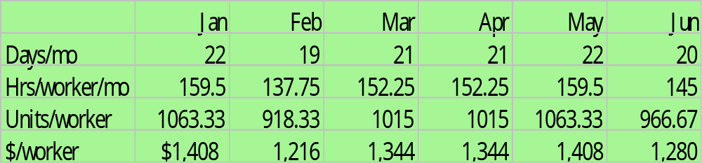
Cut-and-Try Example: Determining
Straight Labor Costs and Output
Given the demand and cost information below, what
are the aggregate hours/worker/month, units/worker, and dollars/worker?
7.25x22
Demand/mo Jan Feb Mar Apr May Jun
4500 5500 7000 10000 8000 6000
Productive hours/worker/day 7.25
Paid straight hrs/day 8
7.25x0.15=48.33 & 84.33x22=1063.33
22x8hrsx$8=$1408

Slide 12
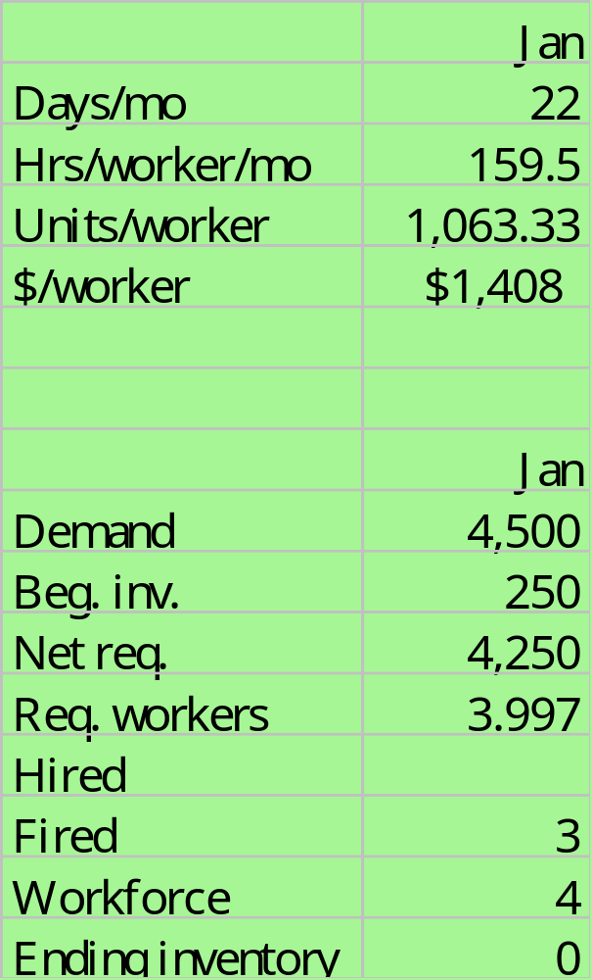
Chase Strategy
(Hiring & Firing to meet demand)
Lets assume our current workforce is 7 workers.
First, calculate net requirements for production, or 4500-250=4250 units
Then, calculate number of workers needed to produce the net requirements, or 4250/1063.33=3.997 or 4 workers
Finally, determine the number of workers to hire/fire. In this case we only need 4 workers, we have 7, so 3 can be fired.
Notes:
13
13

Slide 13
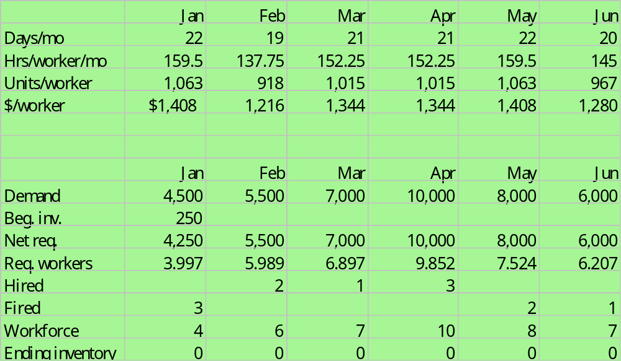
Below are the complete calculations for the remaining months in the six month planning horizon
Notes:
14
14

Slide 14
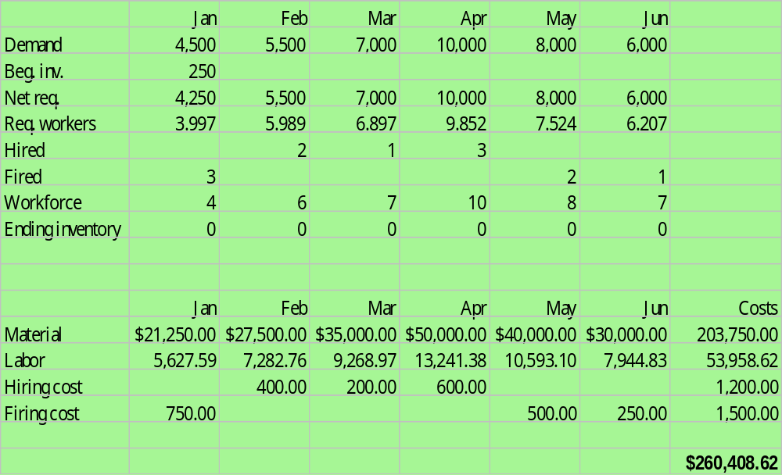
Below are the complete calculations for the remaining months in the six month planning horizon with the other costs included
Notes:
15
15

Slide 15
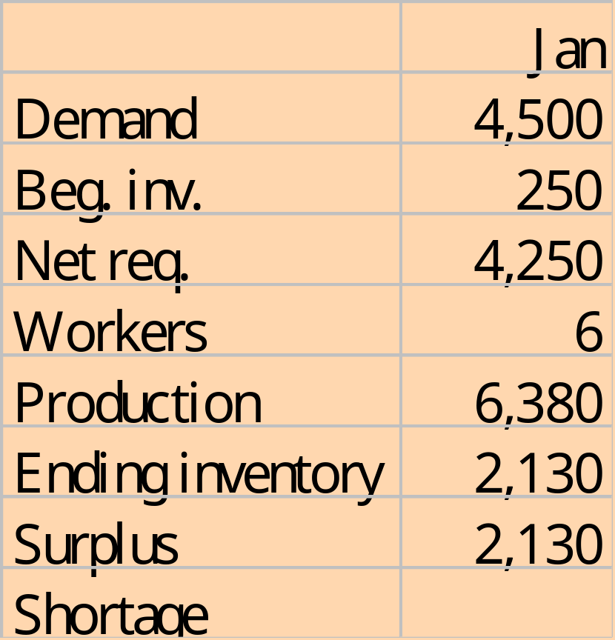
Level Workforce Strategy (Surplus and Shortage Allowed)
Lets take the same problem as before but this time use the Level Workforce strategy
This time we will seek to use a workforce level of 6 workers
Notes:
16
16

Slide 16
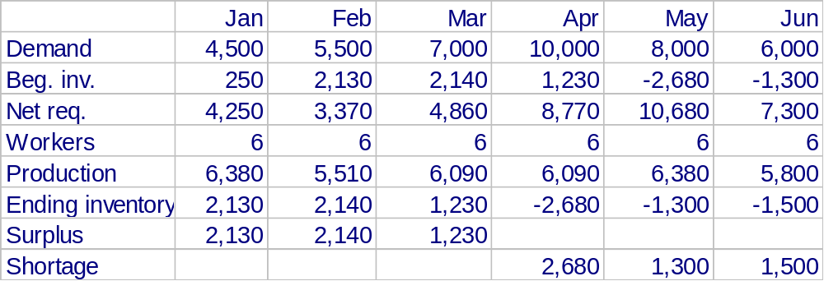
Below are the complete calculations for the remaining months in the six month planning horizon
Note, if we recalculate this sheet with 7 workers we would have a surplus
Notes:
17
17

Slide 17
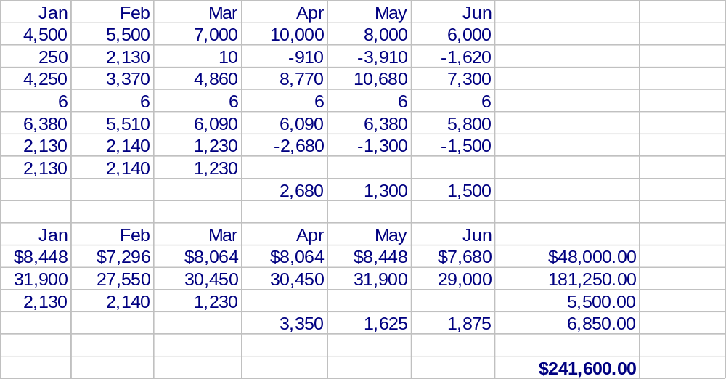
Below are the complete calculations for the remaining months in the six month planning horizon with the other costs included
Note, total costs under this strategy are less than Chase at $260.408.62
Labor
Material
Storage
Stockout
Notes:
18
18

Slide 18
End of Chapter 13
Notes:
2
2

